Slide 1
Data Structures and Algorithms -3 (25CS2103E)
Logistics Optimization Using Minimum-Cost Maximum-Flow
Team Members
Yalamanchili Yashwanth (2520030506)
Sanjana Kanaparthi (2520030229)
Gajengi Keerthi (2520030092)
Team 17 | Section 5
Under the Esteemed Guidance of
Dr. Swathi, Department of CSE

Slide 2
Contents
Abstract
Introduction
Literature Survey
Problem Statement and Objectives
Flow Chart
Results
Hardware and Software Requirements
Conclusion
Future Scope

Slide 3



Abstract
Businesses must move goods from warehouses to destinations at the lowest possible cost. This project turns that problem into a flow network: warehouses, destinations and routes are the points and links, each route has a capacity (shipment limit) and a cost (transport expense).
The Minimum-Cost Maximum-Flow (MCMF) algorithm then decides how much to ship on each route, so that all supply and demand limits are respected and the total cost is as low as possible.
A detailed cost report and a picture of the network make the optimized plan easy to understand.
INPUT
Warehouses (supply), destinations (demand) and routes with capacity and cost
METHOD
MCMF finds the cheapest way to move the maximum possible cargo
OUTPUT
Routes used, quantity shipped, cost per route, total cost and network view

Slide 4



Introduction
What is logistics?
Moving goods from where they are stored (warehouses) to where they are needed (destinations).
14
hubs (cities) across India
Why does cost matter?
Many routes exist by road, rail and air, each with a limit and a price. A poor choice wastes money or leaves orders undelivered.
22
scheduled road, rail and air services
Our solution: CargoRoute
A Java desktop application that uses Minimum-Cost Maximum-Flow to deliver the maximum cargo at the lowest total cost.
3
transport modes: truck, train, flight

Slide 5
Literature Survey
Work | What it contributed | How it helps our project
Hitchcock (1941) | Defined the transportation problem: ship a product from several sources to many destinations at least cost. | The same real-world problem our system solves.
Ford & Fulkerson (1956) | Introduced maximum flow using augmenting paths in a network with capacities. | Basis of the “maximum flow” and residual-graph ideas.
Bellman (1958) and Ford (1956) | Bellman–Ford shortest-path method, which also works with negative edge costs. | Finds the cheapest path in the residual graph, where reverse edges have negative cost.
Edmonds & Karp (1972) | Showed that augmenting along shortest paths gives guaranteed running time; extended to min-cost flow. | Supports our shortest-augmenting-path approach.
Ahuja, Magnanti & Orlin (1993) | Textbook “Network Flows”: standard reference for min-cost flow algorithms. | Guide for implementing and understanding MCMF.
Gap: earlier work gives the theory; our project turns it into a working tool with routes, quantities and costs.

Slide 6

Problem Statement and Objectives
Objectives
Problem Statement
Model warehouses, destinations and routes as a flow network (capacity and cost).
1
Goods must travel from warehouses to destinations over routes that each have a limited capacity and a different cost.
Choosing routes by guesswork wastes money or leaves demand unmet. We need a system that ships the maximum cargo at the minimum total cost.
2
Apply the Minimum-Cost Maximum-Flow algorithm to find the best shipment plan.
3
Respect supply, demand and route-capacity limits at all times.
4
Show a cost report: routes used, quantity shipped, cost per route and total cost.
5
Give a visual view of the network so the result is easy to understand.

Slide 7
Flow Chart
Start
Read input
Hubs, services (capacity and cost), cargo weight
Build flow network
Source, sink, forward and reverse edges
Find cheapest path
Bellman–Ford on residual graph
repeat
In simple words
Residual graph: keeps track of how much room is still free on every route.
Reverse edges: let the algorithm undo an earlier choice when a cheaper plan exists.
Bellman–Ford: finds the cheapest path even when some edge costs are negative.
Path found and demand left?
Send flow
Push the bottleneck amount, update residual graph and cost
Yes
No
End
Show cost report
Routes, quantity, cost, total cost

Slide 8
Results
70 t
Cargo delivered (70 t requested)
₹3,54,850
Minimum total transport cost
2 routes
Used: 65 t via Bhopal, 5 t via Nagpur
Optimized plan: Hyderabad → Delhi, 70 t
Sample runs of the CargoRoute planner
Shipment | Min. cost | Result
Hyderabad → Delhi, 8.5 t | ₹41,565 | All delivered via Bhopal (train)
Hyderabad → Delhi, 70 t | ₹3,54,850 | 65 t via Bhopal, 5 t via Nagpur
Mumbai → Bengaluru, 9.2 t | ₹77,418 | All delivered via Pune (truck)
Hyderabad → Delhi, 8.5 t, flights only | — | 0 t: no flight route exists
Bhopal
Train · 65 t
₹1,65,750
Train · 65 t
₹1,52,100
Hyderabad
Delhi
Truck · 5 t
₹21,250
Train · 5 t
₹15,750
Nagpur
The cheapest route (via Bhopal, ₹4,890 per tonne) is full at 65 t, so the last 5 t take the next cheapest route (via Nagpur, ₹7,400 per tonne).

Slide 9


Hardware and Software requirements
Hardware
Software
Processor
Dual-core 2 GHz or better
Language
Java (JDK 17 or later)
RAM
4 GB minimum (8 GB recommended)
GUI
Java Swing, built into the JDK
Storage
About 200 MB free space
Build tool
Maven (optional) or plain javac
Display
1080 × 700 or larger
OS
Windows, Linux or macOS
Internet
Not needed, runs offline
Editor
IntelliJ IDEA, VS Code or Eclipse

Slide 10


Conclusion
Lowest cost
Limits respected
MCMF uses the cheapest routes first and turns to costlier ones only when cheaper routes are full.
No route carries more than its capacity, and supply and demand are always taken into account.
Easy to understand
Practical
The cost report lists routes, quantities, cost per route and the total cost.
Works across road, rail and air services in a network of 14 hubs, showing how graph algorithms help real supply chains.
Graph algorithms turn a complex shipping decision into a clear, cost-saving plan.

Slide 11






Future Scope
Live data and tracking
Many warehouses at once
Faster algorithms
Connect to real carrier and GPS systems for current prices and schedules.
Handle several warehouses and several destinations in one plan.
Use quicker shortest-path methods so very large networks solve in less time.
Map view
More real-life rules
Smart forecasting
Show routes on an interactive map, on the web and on mobile.
Add delivery deadlines, priorities and emissions to the cost.
Predict future demand with machine learning and store history in a database.

Slide 12
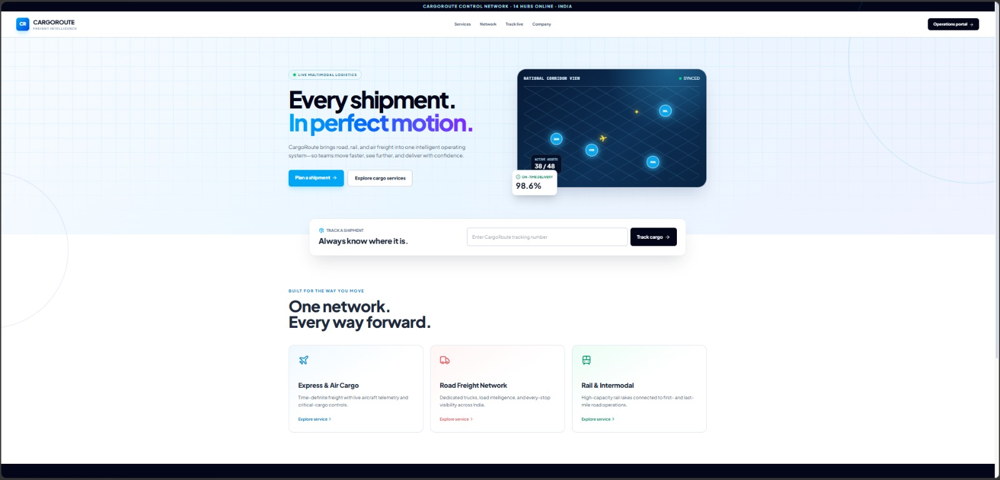
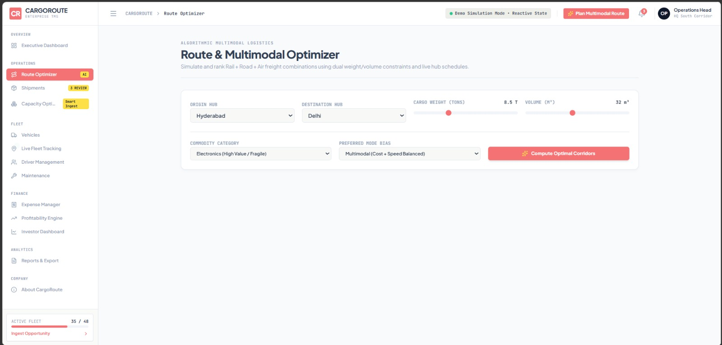
OUTPUT:

Slide 13


GEO tag:
Future Scope

Slide 14
Thank you

